Slide 1
CSEP504: Advanced topics in software systems
Tonight: 2nd of three lectures on software tools and environments – a few tools in some more depth
February 22 (Reid Holmes): Future directions and areas for improvement – rationale behind the drive towards integration
Capturing latent knowledge
Task specificity / awareness
Supporting collaborative development
The plan for the final two lectures
David Notkin  Winter 2010  CSEP504 Lecture 5
Notes:
Lecture 1: Tools & Environments (roles and historical perspectives) - What are the main roles of tools in our development process? - Understanding - Building - Modifying - Debugging - Testing - Historical overview of how we got to here: - (Wouldn't bother with pre-basic editors) - text editors galore - emacs & other syntax-aware editors - semantically-aware editors (e.g. pascal) - smalltalk - modern environments (visual studio, eclipse, etc) - What new development approaches will _require_ specific tools? - Modelling - SMT stuff from 590N seminar (incl verifying protocols)

Slide 2
Announcements
The second state-of-the-research paper can be on any approved topic in software engineering research
That is, it needn’t be focused on one of the core topics in the course
Everything else stays the same (due dates, groups, commenting, etc.)
Comment away on the first state-of-the-research papers!

Slide 3
Announcements
March 1:
Report from India (Microsoft Research, discussions about starting a software engineering center, etc.) [~30 minutes]
Different ways to evaluate and assess software engineering research [~60-90 minutes]
March 8: SE economics (I will post readings soon)

Slide 4
Languages and tools
In preparing for this lecture, one possible topic Reid and I discussed was “languages as tools”
The premise is that different programming languages support different development methodologies and have particular strengths
Another lightly related question is how to decide between placing something in a language or in a tool: as an example, consider lint vs. types
But no deep discussion tonight

Slide 5
Tonight
Concolic testing – in depth
Continuous testing – not in depth
Carving from system tests – even less in depth
Speculation – discussion about the idea
LSDiff – in depth
Reflexion models – in some depth

Slide 6
Testing Not full-fledged testing lectures!
What questions should testing – broadly construed – answer about this itsy-bitsy program?
What criteria should we use to assess different approaches to testing it?
if (x > y) {
x = x + y;
y = x – y;
x = x – y;
if (x > y)
assert(false)
}
Example from Visser, Pasareanu & Mehlitz

Slide 7
Control flow graph (CFG)
x >? y
x = x + y
Can this statement ever be executed?
y = x – y
x = x – y
x >? y
assert(false)
end

Slide 8
Edge coverage
[x=1;y=0]
x >? y
[x=1;y=0]
x = x + y
[x=1;y=1]
y = x – y
[x=0;y=1]
[x=0;y=1]
x = x – y
Edge ever taken?
x >? y
assert(false)
end

Slide 9
Symbolic execution [x=α;y=β]
x >? y
[x=α+β;y=β]
x = x + y
[x=α+β;y=α]
y = x – y
[α <= β]
[x=β;y=α]
x = x – y
β>α ever here?
[x=β;y=α]
x >? y
assert(false)
end

Slide 10
Symbolic execution
x >? y
[α > β]
[x=α+β;y=β]
x = x + y
[x=α+β;y=α]
y = x – y
[α <= β]
[x=β;y=α]
x = x – y
β < α here
[x=β;y=α]
x >? y
assert(false)
end

Slide 11
What’s really going on?
if (x > y) {
x = x + y;
y = x – y;
x = x – y;
if (x > y)
assert(false)
}
Create a symbolic execution tree
Explicitly track path conditions
Solve path conditions – “how do you get to this point in the execution tree?” – to defines test inputs
Goal: define test inputs that reach all reachable statements
[true] x = α,y = β
[true] α >? β
[α > β] x = α + β
[α <=β] end
[α > β] x=β;y=α
[α > β] β >? α
[α>β & β>α] “false”
[α>β & β <=α] end

Slide 12
Another example (Sen and Agha)
[true] x = α,y = β
[true] z = 2 * β
[true] 2 * β ==? α
[2 * β != α] end
[2 * β = α] α >? β + 10
[2 * β = α & α > β + 10] error
[2 * β = α & α <= β + 10] end
int double (int v){
return 2*v;
}
void testme (int x, int y){
z = double (y);
if (z == x) {
if (x > y+10) {
ERROR;
}}}

Slide 13
Error: possible by solving equations
[2 * β = α & α > β + 10]
≡ [2 * β > β + 10]
≡ [β > 10]
≡ [β > 10 & 2 * β = α ]

Slide 14
Way cool – we’re done!
First example can’t reach assert(false), and it’s easy to reach end via both possible paths
Second example: can reach error and end via both possible paths
Well, what if we can’t solve the path conditions?
Some arithmetic, some recursion, some loops, some pointer expressions, etc.
We’ll see an example
What if we want specific test cases?

Slide 15
Concolic testing: Sen et al.
Basically, combine concrete and symbolic execution
More precisely…
Generate a random concrete input
Execute the program on that input both concretely and symbolically simultaneously
Follow the concrete execution and maintain the path conditions along with the corresponding symbolic execution
Use the path conditions collected by this guided process to constrain the generation of inputs for the next iteration
Repeat until test inputs are produced to exercise all feasible paths

Slide 16
2nd example redux 1st iteration x=22, y=7
int double (int v){
return 2*v;
}
void testme (int x, int y){
z = double (y);
if (z == x) {
if (x > y+10) {
ERROR;
}}}
[true] x = α = 22, y = 7 = β
[true] z = 14 = 2 * β
[true] 2 * β ==? α 14 ==? 22
[2 * β = α] …
[2 * β != α] end
Now solve 2 * β = α to force the other branch
x = 1; y = 2 is one solution

Slide 17
2nd example 2nd iteration x=1, y=2
int double (int v){
return 2*v;
}
void testme (int x, int y){
z = double (y);
if (z == x) {
if (x > y+10) {
ERROR;
}}}
[true] x = α = 1,y = β = 2
[true] z = 2 * β = 4
[true] 2 * β ==? α 2 ==? 2
[2 * β = α] α >? β + 10 1 >? 2 + 10
[2 * β != α] …
[2 * β = α & α > β + 10]
[2 * β = α & α <= β + 10]
Now solve 2 * β = α & α <= β + 10 to force the other branch
x = 30; y = 15 is one solution

Slide 18
2nd example 3nd iteration x=30, y=15
int double (int v){
return 2*v;
}
void testme (int x, int y){
z = double (y);
if (z == x) {
if (x > y+10) {
ERROR;
}}}
[true] x = α = 30,y = β = 15
[true] z = 2 * β = 30
[true]
[2 * β = α] α >? β + 10 30 >? 15 + 10
[2 * β != α] …
[2 * β = α & α > β + 10] [30 = 30 & 30 > 25] error
[2 * β = α & α <= β + 10]
Now solve 2 * β = α & α <= β + 10 to force the other branch
x = 30; y = 15 is one solution

Slide 19
Three concrete test cases
int double (int v){ return 2*v;}
void testme (int x, int y){
z = double (y);
if (z == x) {
if (x > y+10) {
ERROR;
}
}
}
x | y
22 | 7 | Takes first else
2 | 1 | Takes first then and second else
30 | 15 | Takes first and second then

Slide 20
Concolic testing example: P. Sağlam
Random seed
x = -3; y = 7
Concrete
z = 9
Symbolic
z = x³+3x²+9
Take then branch with constraint x³+3x²+9 != y
void test_me(int x,int y){
z = x*x*x + 3*x*x + 9;
if(z != y){
printf(“Good branch”);
} else {
printf(“Bad branch”);
abort();
}
}
Take else branch with constraint x³+3x²+9 = y

Slide 21
Concolic testing example: P. Sağlam
Solving is hard for x³+3x²+9 = y
So use z’s concrete value, which is currently 9, and continue concretely
9 != 7 so then is good
Symbolically solve 9 = y for else clause
Execute next run with x = -3; y = 9 so else is bad
void test_me(int x,int y){
z = x*x*x + 3*x*x + 9;
if(z != y){
printf(“Good branch”);
} else {
printf(“Bad branch”);
abort();
}
}
When symbolic expression becomes unmanageable (e.g., non-linear) replace it by concrete value

Slide 22
Concolic testing example: P. Sağlam
Random
Random memory graph reachable from p
Random value for x
Probability of reaching abort( ) is extremely low
(Why is this a somewhat misleading motivation?)
typedef struct cell {
int v;
struct cell *next;
} cell;
int f(int v) {
return 2*v + 1;
}
int testme(cell *p, int x) {
if (x > 0)
if (p != NULL)
if (f(x) == p->v)
if (p->next == p)
abort();
return 0;
}

Slide 23
Let’s try it
typedef struct cell {
int v;
struct cell *next;
} cell;
int f(int v) {
return 2*v + 1;
}
int testme(cell *p, int x) {
if (x > 0)
if (p != NULL)
if (f(x) == p->v)
if (p->next == p)
abort();
return 0;
}
Concrete | Symbolic | Constraints
p=NULL; x=236

Slide 24
Let’s try it
typedef struct cell {
int v;
struct cell *next;
} cell;
int f(int v) {
return 2*v + 1;
}
int testme(cell *p, int x) {
if (x > 0)
if (p != NULL)
if (f(x) == p->v)
if (p->next == p)
abort();
return 0;
}
Concrete | Symbolic | Constraints
p=[634,NULL]; x=236

Slide 25
Let’s try it
typedef struct cell {
int v;
struct cell *next;
} cell;
int f(int v) {
return 2*v + 1;
}
int testme(cell *p, int x) {
if (x > 0)
if (p != NULL)
if (f(x) == p->v)
if (p->next == p)
abort();
return 0;
}
Concrete | Symbolic | Constraints
p=[3,p]; x=1

Slide 26
Let’s try it
typedef struct cell {
int v;
struct cell *next;
} cell;
int f(int v) {
return 2*v + 1;
}
int testme(cell *p, int x) {
if (x > 0)
if (p != NULL)
if (f(x) == p->v)
if (p->next == p)
abort();
return 0;
}
Concrete | Symbolic | Constraints

Slide 27
Concolic: status
The jury is still out on concolic testing – but it surely has potential
There are many papers on the general topic
Here’s one that is somewhat high-level Microsoft-oriented
Godefroid et al. Automating Software Testing Using Program Analysis IEEE Software (Sep/Oct 2008)
They tend to call the approach DART – Dynamic Automated Random Testing

Slide 28
DART
From P. Godefroid

Slide 29
My take
The real story is the combination of symbolic evaluation, model checking, automated theorem proving, concrete testing, etc.
These are being used and combined in ways that were previously not considered and/or were previously infeasible
One other point: few if any of these systems actually help produce test suites with oracles – they rather help produce sets of test inputs that provide some kind of structural coverage
This is fine, but it is not the full testing story – making sure the program computes what is wanted is also crucial

Slide 30
An aside: sources of unsoundness
Matt Dwyer and colleagues have observed that in any form of analyzing a program (including analysis, testing, proving, …) there is a degree of unsoundness
How do we know that
every desired property (correctness, performance, reliability, security, usability, …) is achieved in
every possible execution?
We don’t – so we need to know what we know, and what we don’t know

Slide 31
Sample across executions
Requirements
Behaviors

Slide 32
Sample across requirements
Deadlock
Requirements
Data structure invariants
Freedom from races
Behaviors

Slide 33
Continuous testing: Ernst et al.
Run regression tests on every keystroke/save, providing rapid feedback about test failures as source code is edited
Objectives: reduce the time and energy required to keep code well-tested, and prevent regression errors from persisting uncaught for long periods of time

Slide 34
Key results include
Developers using continuous testing were three times more likely to complete the task before the deadline than those without (in a controlled experiment)
Most participants found continuous testing to be useful and believed that it helped them write better code faster, and 90% would recommend the tool to others.
Experimental supporting evidence that reducing the time between the introduction of an error and its discovery by a developer can lead to improvements in overall development time.

Slide 35
Test factoring
“Expensive” tests (taking a long time to run, most often) are hard to handle “continuously” when they begin to fail
Test factoring, given a large test, produces one or more smaller tests
Each of these smaller tests is unlikely to fail unless the large test fails, and likely to regress (start to fail) when the large test regresses due to a particular kind of program change.

Slide 36
More details…
Clever engineering, clever evaluation, and more
http://www.cs.washington.edu/homes/mernst/research/#Testing (including continuous testing – old page at MIT)

Slide 37
Carving differential unit test cases from system test cases: Elbaum et al. FSE TSE
Unit test cases are focused and efficient
System tests are effective at exercising complex usage patterns
Differential unit tests (DUT) are a hybrid of unit and system tests that exploits their strengths
DUTs are generated by carving the system components, while executing a system test case, that influence the behavior of the target unit, and then re-assembling those components so that the unit can be exercised as it was by the system test
Architecture, framework, implementation and empirical assessment of carving and replaying DUTs on three software artifacts

Slide 38
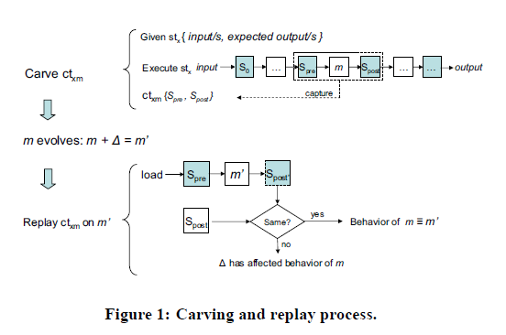
From FSE paper
“The Carving project is now a part of the new, bigger, and more ambitious T2T: Test-to-Test Transformation Project”

Slide 39
Speculation: again
Continuous testing – in essence, trying to keep everything as up-to-date as possible
Using cycles for quality (not primarily for performance)
Same two speculation slides, same motivation
What if we had infinite cycles for quality and could provide up-to-date information about a set of possible actions?
This would also provide instantaneous transition to a new program state once an action was selected
Discussion

Slide 40
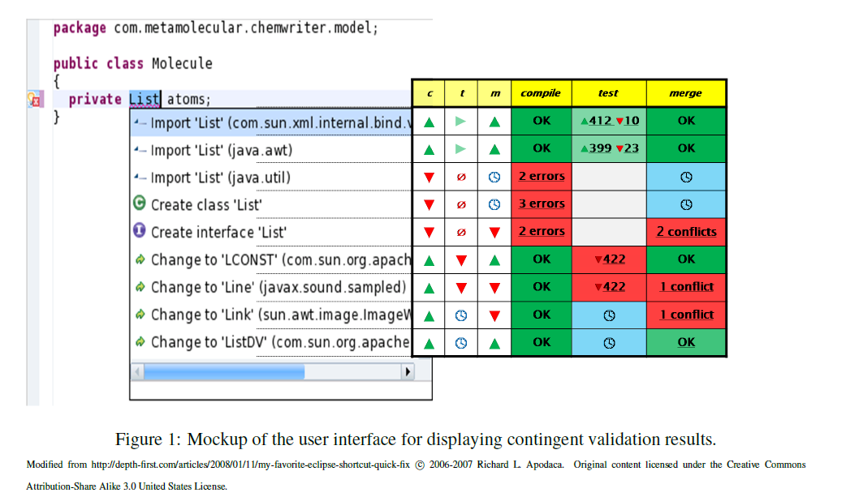
Speculation: ongoing research @ UW

Slide 41
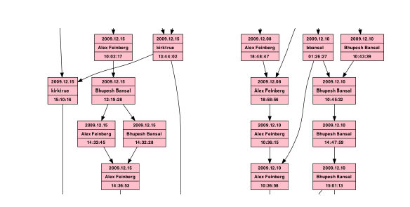
Speculation over merging?

Slide 42
LSDiff (M. Kim et al.): Help answer questions like …
Did Steve implement the intended changes correctly?
There’s a merge conflict. What did Sally change?
Check-in comment (revision 429 of carol open source project) “Common methods go in an abstract class. Easier to extend/maintain/fix”
What changed?

Slide 43
What changed?
Was it really an extract superclass refactoring? Was any part of the refactoring missed? Did Steve make any other changes?
File Name | Status | #Lines
DummyRegistry | New | 20
AbsRegistry | New | 133
JRMPRegistry | Modified | 123
JeremieRegistry | Modified | 52
JacORBCosNaming | Modified | 133
IIOPCosNaming | Modified | 50
CmiRegistry | Modified | 39
NameService | Modified | 197
NameServiceManager | Modified | 15
Changed code: 9 files, 723 lines

Slide 44
Try diff
File Name | Status | #Lines
DummyRegistry | New | 20
AbsRegistry | New | 133
JRMPRegistry | Modified | 123
JeremieRegistry | Modified | 52
JacORBCosNaming | Modified | 133
IIOPCosNaming | Modified | 50
CmiRegistry | Modified | 39
NameService | Modified | 197
NameServiceManager | Modified | 15
Changed code: 9 files, 723 lines

Slide 45
Try diff
File Name | Status | #Lines
DummyRegistry | New | 20
AbsRegistry | New | 133
JRMPRegistry | Modified | 123
JeremieRegistry | Modified | 52
JacORBCosNaming | Modified | 133
IIOPCosNaming | Modified | 50
CmiRegistry | Modified | 39
NameService | Modified | 197
NameServiceManager | Modified | 15
Changed code: 9 files, 723 lines
- public class CmiRegistry implements NameService { + public class CmiRegistry extends AbsRegistry implements NameService { - private int port = ... - private String host = null - public void setPort (int p) { - if (TraceCarol. isDebug()) { ... - } - } - public int getPort() { - return port; - } - public void setHost(String host) { ...

Slide 46
Related diff-like approaches
Syntactic Diff (Cdiff), Semantic Diff, Jdiff, BMAT, Eclipse diff, UMLdiff, Change Distiller, …
They individually compare code elements at specific granularities using various similarity measures
Code elements may be lines, abstract syntax trees, control flow graphs, etc.
Similarity is usually based on names and structure
These tools provide information that is accurate and useful but not well-suited to helping engineers and managers answer the kinds of questions we want

Slide 47
Use systematic change
Existing diff-based tools do not exploit the fact that programmers often make high-level changes in part by systematically applying lower-level changes
Systematic changes are widespread; examples include
Refactoring [Opdyke 92, Griswold 92, Fowler 99...]
API update [Chow & Notkin 96, Henkel & Diwan 05, Dig & Johnson 05...]
Crosscutting concerns [Kiczales et. al. 97, Tarr et. al. 99, Griswold 01...]
Consistent updates on code clones [Miller & Myers 02, Toomim et. al. 04, Kim et. al. 05, …]

Slide 48
Limitations of diff-based approaches
These approaches do not group related changes with respect to a high-level change – but rather by structural program units such as files
In part because of this first limitation, they do not make it easy to identify incomplete or missed parts of high-level changes
They leave it to the programmer to discover any useful contextual information surrounding the low-level changes
In other words, these approaches are program-centric but not change-centric

Slide 49
Ex: No change-based grouping
Toyota.java
GM.java
+ ...
BMW.java
+ ...
+ ...
- start();
+ begin();
- start();
+ begin();
- start();
+ begin();
The programmer must determine that the same changes have been made in these three related classes – if they even choose to think about this

Slide 50
Ex: Hard to see missed changed
Toyota.java
GM.java
+ ...
BMW.java
+ ...
+ ...
- start();
+ begin();
- start();
- start();
+ begin();
The programmer must decide to look for a missing or inconsistent change – there is no help from the tool

Slide 51
Ex: Lack of contextual information
class Car ...
run () {
...
}
class GM extends Car
class BMW extends Car
class Toyota extends Car
+ run(){
+ ...
+ }
+ run(){
+ ...
+ }
+ run(){
+ ...
+ }
Three subclasses of a class changed in the same way would not be identified by the tools themselves

Slide 52
The Logical Structural Diff Approach
LSDiff computes structural differences between two versions using logic rules and facts
Each rule represents a group of transformations that share similar structural characteristics – a systematic change
Our inference algorithm automatically discovers these rules
Notes:
To complement existing program differencing approaches, our approach computes differences at the level of code elements and structural dependencies and represents them using logic rules and facts.
Each rule represents a group of transformations that share similar structural characteristics.
Our inference algorithm automatically discovers these rules.

Slide 53
Conciseness
Toyota.java
GM.java
+ ...
BMW.java
+ ...
+ ...
- start();
+ begin();
- start();
+ begin();
- start();
+ begin();
LSD Rule

Slide 54
Explicit exceptions
Toyota.java
GM.java
+ ...
BMW.java
+ ...
+ ...
- start();
+ begin();
- start();
- start();
+ begin();
LSD Rule
√
X
√

Slide 55
Additional context
class Car ...
run () {
...
}
LSD
same rule
class GM extends Car
class BMW extends Car
class Toyota extends Car
+ run(){
+ ...
+ }
+ run(){
+ ...
+ }
+ run(){
+ ...
+ }
Rule

Slide 56
Program representation
We abstract Java programs at the level of code elements and structural dependencies
Predicates represent package, type, method, field, sub-typing, overriding, method calls, field accesses and containment relationships
package
type
method
field
return
fieldoftype
typeintype
accesses
calls
subtype
inheritedfield
inheritedmethod

Slide 57
Fact-based representation
Analyze a program’s abstract syntax tree and return a fact-base of these predicates (using JQuery [Jensen & DeVolder 03])
Repeat for the modified program
type(“Bus”,..)
method(“Bus.start”,”start”,”Bus”)
access(“Key.on”,”Bus.start”)
method(“Key.out”,”out”,”Key”)...
Old program
FB_{o}
past_
type(“Bus”,..)
method(“Bus.start”,”start”,”Bus”)
calls(“Bus.start”,”log”)
method(“Key.output”,”output”,”Key”)...
New program
FB_{n}
current_

Slide 58
Compute ΔFB = FB_{o} - FB_{n}
deleted_access(“Key.on”,”Bus.start”)
added_calls(“Bus.start”,”log”)
deleted_method(“Key.out”,”out”,”Key”)
added_method(“Key.output”,”output”,”Key”) ...

Slide 59
LSDiff Rule Quantification
Rules represent systematic structural differences that relates groups of facts from the three fact-bases – FB_{o}, FB_{n}, ΔFB
Universally quantified variables allow rules to represent a group of similar facts at once
For example, ∀m∀t method(m,”setHost”,t) refers to all methods named setHost in all types
Ex: ∀t subtype(“Service”, t)
Ex: ∀m calls(m, “SQL.exec”)

Slide 60
LSD Rules
Rules are Horn clauses where a conjunction of logic literals implies a single consequent literal
∀m ∀t method(m, “setHost”, t) ∧ subtype(“Service”, t) ⇒ calls(m, “SQL.exec”)

Slide 61
Rules across versions
∀m ∀t past_method(m, “setHost”, t) ∧ past_subtype(“Service”, t) ⇒ deleted_calls(m, “SQL.exec”)

Slide 62
Rules note exceptions
∀m ∀t past_method(m, “setHost”, t) ∧ past_subtype(“Service”, t) ⇒ deleted_calls(m, “SQL.exec”) except t=“NameSvc”, m=”NameSvc.setHost”
“All setHost methods in Service’s subclasses in the old version deleted calls to SQL.exec except the setHost method in the NameSvc class.”
A parameter defines when exceptions are found and reported

Slide 63
Algorithm Overview
P_{o}
P_{n}
logic rules and facts that explain structural differences
Extract logic facts from programs and compute fact-level differences
Learn rules using a customized inductive logic programming algorithm
Select a subset of rules and then remove the facts in ΔFB using the learned rules
Notes:
So far, we explained our rule-based change representation. Now I am going to explain how we automatically infer such rules.
Our algorithm takes two program versions as input and outputs logic rules and facts.
It consists of three steps. We first extracts logic facts from input programs using JQuery and then compute differences between two factbases.
Then we learn rules by using our customized inductive logic programming algorithm.
We select a subset of rules and then winnow out the fact-level differences using the learned rules.

Slide 64
Learn rules
Inductive logic programming with a bounded depth search based on beam search heuristics
Input parameters determine the validity of a rule
m: the minimum # of facts a rule must match – enough evidence for a rule?
a: the minimum accuracy of a rule – enough evidence for an exception?
k: the maximum # of literals in an antecedent
β: the window size for beam search
A sequential covering algorithm that iteratively finds rules and removes covered facts
Generate rules starting with an empty antecedent and adding literals (e.g., from general to specific)
Learn partially grounded rules by substituting variables of ungrounded rules with constants
Notes:
In step 3 of our algorithm, we learn rules from all three fact-bases.
We developed a customized ILP algorithm to learn rules with predefined styles. Our algorithm takes several input parameters that define validity of a rule.

Slide 65
Learn rules
R := {} // a set of ungrounded rules L := {} // a set of valid learned rules
D := reduced ΔFB using default winnowing rules
for each antecedent size, i = 0...k :
R := extend all rules in R by adding all possible literals
for each ungrounded rule, r:
for each possible grounded rule g of r:
if (g is valid) L:= L ∪ g R := select the best β rules in R
D := D - { facts covered by L }

Slide 66
Select rules
Some rules explain the same set of facts in ΔFB
So we use a set cover algorithm to select a subset of learned rules
Return the selected rules, remove the facts that those rules cover, and return any remaining uncovered facts in ∆FB

Slide 67
LSD Example
To prevent an injection attack, a programmer replaced all calls to SQL.exec to SafeSQL.exec
LSD infers the following rule
deleted_calls(m,“SQL.exec”) ⇒ added_calls(m,“SafeSQL.exec”)
And another rule we’ve seen before, suggesting a deletion was not done
past_subtype(“Service”, t) ∧ past_method(m, “setHost”, t) ⇒ deleted calls(m, “SQL.exec”) except t=“NameSvc”

Slide 68
Quantitative evaluation
How often do individual changes form systematic change patterns?
Measure coverage, # of facts in ∆FB matched by inferred rules
How concisely does LSD describe structural differences in comparison to existing differencing approach at the same abstraction level?
Measure conciseness, ∆FB / (# rules + # facts)
How much contextual information does LSD find from unchanged code fragments?
Measure the number of facts mentioned by rules but are not contained in ∆FB

Slide 69
Quantitative evaluation
a=0.75, m=3, k=2, β=100
 | FB_{o}/FB_{n} | ∆FB | Rule | Fact | Cover- age | Concise- ness | Context facts
carol 10 revisions | 3080 ~ 10746 | 15 ~ 1812 | 1 ~ 36 | 3 ~ 71 | 59 ~ 98% | 2.3 ~ 27.5 | 0 ~ 19
dnsjava 29 releases | 3109 ~ 7204 | 4 ~ 1500 | 0 ~ 36 | 2 ~ 201 | 0 ~ 98% | 1.0 ~ 36.1 | 0 ~ 91
LSdiff 10 versions | 8315 ~ 9042 | 2 ~ 396 | 0 ~ 6 | 2 ~ 54 | 0 ~ 97% | 1.0 ~ 28.9 | 0 ~ 12
Notes:
To answer these questions, we applied LSdiff to two open source projects and our LSdiff’s history

Slide 70
Quantitative evaluation
a=0.75, m=3, k=2, β=100
 | FB_{o}/FB_{n} | ∆FB | Rule | Fact | Cover- age | Concise- ness | Context facts
carol 10 revisions | 3080 ~ 10746 | 15 ~ 1812 | 1 ~ 36 | 3 ~ 71 | 59 ~ 98% | 2.3 ~ 27.5 | 0 ~ 19
dnsjava 29 releases | 3109 ~ 7204 | 4 ~ 1500 | 0 ~ 36 | 2 ~ 201 | 0 ~ 98% | 1.0 ~ 36.1 | 0 ~ 91
LSdiff 10 versions | 8315 ~ 9042 | 2 ~ 396 | 0 ~ 6 | 2 ~ 54 | 0 ~ 97% | 1.0 ~ 28.9 | 0 ~ 12
On average, 75% coverage,
9.3 times conciseness improvement,
9.7 additional contextual facts
Notes:
To answer these questions, we applied LSdiff to two open source projects and our LSdiff’s history

Slide 71
Textual Delta vs. LSD
a=0.75, m=3, k=2, β=100
 | Textual Delta |  |  |  | LSD
 | Changed Files | Changed Lines | Hunks | % Touched | Rule | Fact
carol 10 revisions | 1 ~ 35 | 67 ~ 4313 | 9 ~ 132 | 1 ~ 19 | 1 ~ 36 | 3 ~ 71
dnsjava 29 releases | 1 ~ 117 | 5 ~ 15915 | 1 ~ 344 | 2 ~ 100 | 0 ~ 36 | 2 ~ 201
LSdiff 10 versions | 2 ~ 11 | 9 ~ 747 | 2 ~ 39 | 2 ~ 9 | 0 ~ 6 | 2 ~ 54

Slide 72
Textual Delta vs. LSD
a=0.75, m=3, k=2, β=100
 | Textual Delta |  |  |  | LSD
 | Changed Files | Changed Lines | Hunks | % Touched | Rule | Fact
carol 10 revisions | 1 ~ 35 | 67 ~ 4313 | 9 ~ 132 | 1 ~ 19 | 1 ~ 36 | 3 ~ 71
dnsjava 29 releases | 1 ~ 117 | 5 ~ 15915 | 1 ~ 344 | 2 ~ 100 | 0 ~ 36 | 2 ~ 201
LSdiff 10 versions | 2 ~ 11 | 9 ~ 747 | 2 ~ 39 | 2 ~ 9 | 0 ~ 6 | 2 ~ 54
When an average text delta consists of 997 lines across 16 files, LSD outputs an average of 7 rules and 27 facts

Slide 73
Focus group: e-commerce company
Pre-screener survey
Participants: five professional software engineers
industry experience ranging from six to over 30 years
use diff and diff-based version control system daily
review code changes daily except one who did weekly
One hour structured discussion
Professor Kim worked as the moderator
There was also a note-taker and the discussion was audio-taped and transcribed

Slide 74
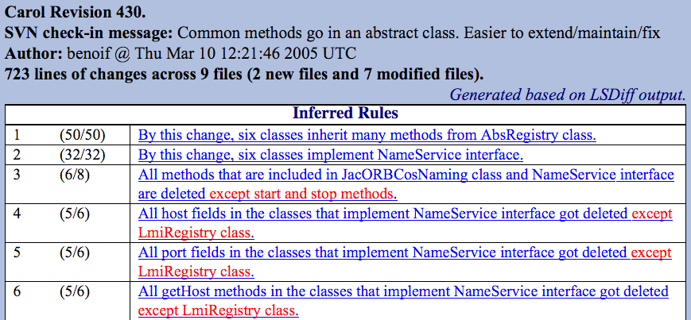
Focus Group Hands-On Trial
Hand-generated html based on LSD output
http://users.ece.utexas.edu/~miryung/LSDiff/carol429-430.htm

Slide 75
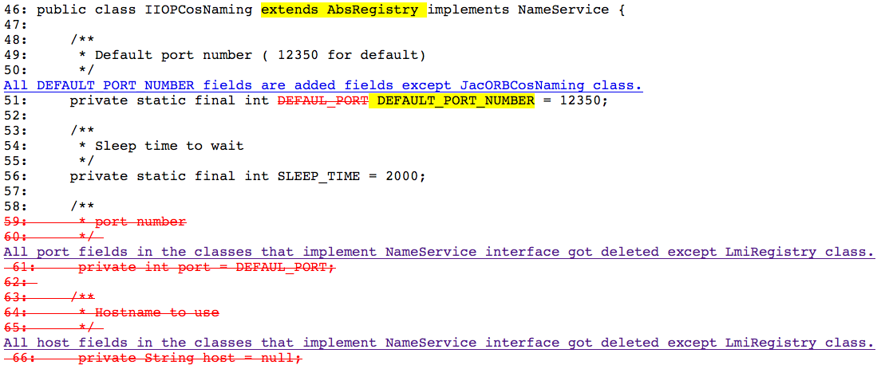

Slide 76
Focus Group Comments (some)
“You can’t infer the intent of a programmer, but this is pretty close.”
“This ‘except’ thing is great!”
“You can start with the summary of changes and dive down to details using a tool like diff.”

Slide 77
Focus group comments (more)
“This looks great for big architectural changes, but I wonder what it would give you if you had lots of random changes.”
“This wouldn’t be used if you were just working with one file.”
“This will look for relationships that do not exist.”
Unsurprising comments as we focus on recovering systematic changes rather than heterogeneous changes
When the delta is small, diff should works fine

Slide 78
LSDiff plug-in for Eclipse
And some other projects related to summarizing changes as rules

Slide 79
Languages and tools Tools and languages
The line between programming languages and tools (programs that help programmers write programs) is sometimes fuzzy
Examples
lint vs. type systems

Slide 80
Summarization
e.g., software reflexion models

Slide 81
Summarization...
A map file specifies the correspondence between parts of the source model and parts of the high-level model [ file=HTTCP mapTo=TCPIP ] [ file=^SGML mapTo=HTML ] [ function=socket mapTo=TCPIP ] [ file=accept mapTo=TCPIP ] [ file=cci mapTo=TCPIP ] [ function=connect mapTo=TCPIP ] [ file=Xm mapTo=Window ] [ file=^HT mapTo=HTML ] [ function=.* mapTo=GUI ]

Slide 82
Summarization...

Slide 83
Summarization...
Condense (some or all) information in terms of a high-level view quickly
In contrast to visualization and reverse engineering, produce an “approximate” view
Iteration can be used to move towards a “precise” view
Some evidence that it scales effectively
May be difficult to assess the degree of approximation

Slide 84
Case study: A task on Excel
A series of approximate tools were used by a Microsoft engineer to perform an experimental reengineering task on Excel
The task involved the identification and extraction of components from Excel
Excel (then) comprised about 1.2 million lines of C source
About 15,000 functions spread over ~400 files

Slide 85
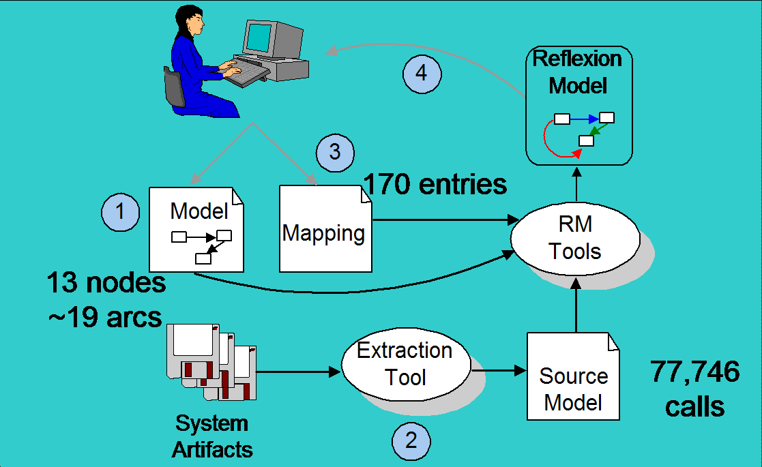
The process used

Slide 86
An initial Reflexion Model
The initial Reflexion Model computed had 15 convergences, 83, divergences, and 4 absences
It summarized 61% of calls in source model

Slide 87
An iterative process
Over a 4+ week period
Investigate an arc
Refine the map
Eventually over 1000 entries
Document exceptions
Augment the source model
Eventually, 119,637 interactions

Slide 88
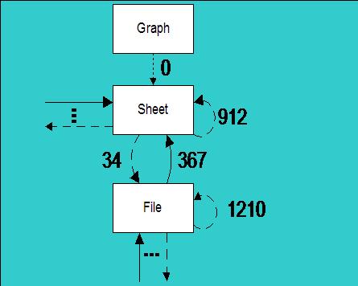
A refined Reflexion Model
A later Reflexion Model summarized 99% of 131,042 call and data interactions
This approximate view of approximate information was used to reason about, plan and automate portions of the task

Slide 89
Results
Microsoft engineer judged the use of the Reflexion Model technique successful in helping to understand the system structure and source code “Definitely confirmed suspicions about the structure of Excel. Further, it allowed me to pinpoint the deviations. It is very easy to ignore stuff that is not interesting and thereby focus on the part of Excel that I want to know more about.” — Microsoft A.B.C. (anonymous by choice) engineer

Slide 90
Open questions
How stable is the mapping as the source code changes?
What if you don’t have a high-level model?
How come it’s not used much at all?
…

Slide 91
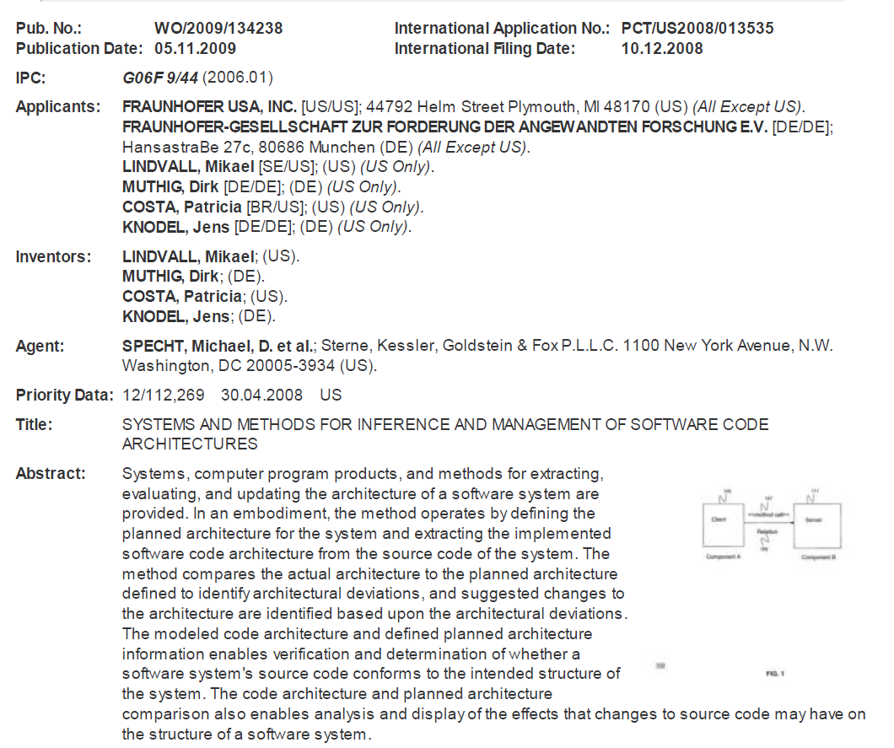
Imitation and flattery

Slide 92
Questions?

